Slide 1
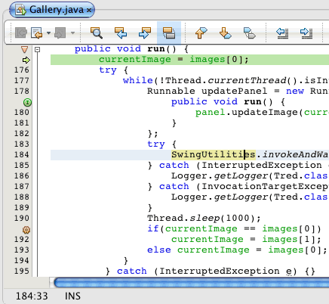
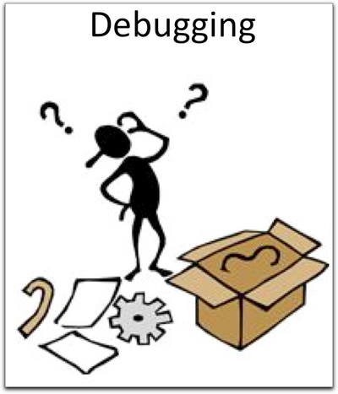
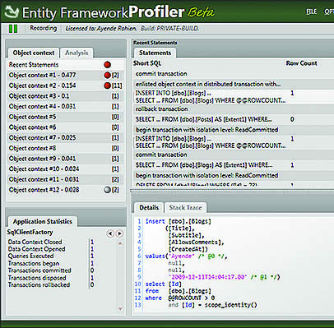
Implementation Details
Advanced Games Programming (CGP600)

Slide 2
What is Visual Studio?
Profiling
Asserts, Macros, Prints
Graphics
Warnings
Halts, __debugbreak, BreakPoints (__asm{ int 3 } )
Source Control (GitHub)

Slide 3
Why is developing a complete game difficult?
Repeatability
Real-time (variable) why?
How catch errors?
Visual identify problems?
Frame-by-frame debugging
Complex interaction/connection of components

Slide 4
Traditional Debugging
Limitations of “cout” and “print” functions?
How to catch NANs?
Detect when things go wrong (limits)?

Slide 5
Temporary Files
What is a temporary file in Visual Studio?
*. ncb, *.opt, *.suo
How much memory do temporary files use?
Relative Paths
i.e., not absolute – e.g., C:\My Documents\John\..
project configuration

Slide 6
Clean Code
Comments
Naming conventions
function names, member variables, globals, statics, macros…
Should be no extra work
– second nature with practice

Slide 7
Warnings
Externs
Statics
Globals
Warnings
difference between 0.0 and 0.0f?
uninitialized variables
casting (void*)

Slide 8
Practicals
Fix Warnings
Should be no warnings in submitted code
If a warning exists – what is the reason? why? (e.g., comment in code)
What is a good and a bad comment?
Readme file

Slide 9
Visual Studio Features
Callstack Window
Watch Window
Float vs Double
Memory
e.g., 0x000000, 0xCDCDCDCD, 0xFEEFEE....
Leaks
Profiling

Slide 10
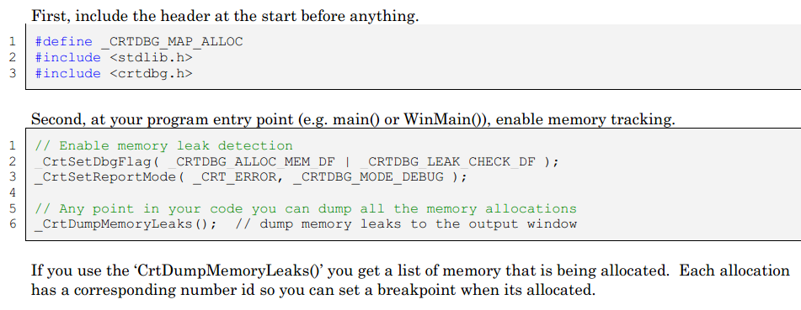
Memory Leaks

Slide 11
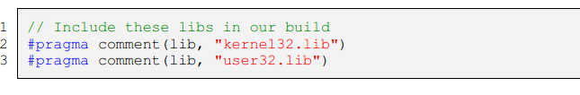
Libraries

Slide 12

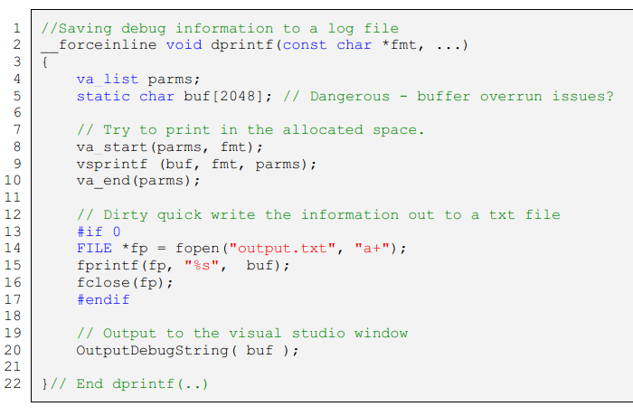
Output Window

Slide 13
Run-Time Memory Information
Windows API
GlobalMemoryStatusEx
For example:
#include <windows.h>
size_t getTotalSystemMemory()
{
MEMORYSTATUSEX status;
status.dwLength = sizeof(status); GlobalMemoryStatusEx(&status);
return status.ullTotalPhys;
}

Slide 14
Release or Debug
Debug Builds (vs Release)
Running Outside Visual Studio
Speed & Memory
Computational Speed (i.e., fps)
Memory Usage (e.g., in real-time)

Slide 15
Essential Graphical Elements
DrawLine(..)
DrawSphere(..)
DrawCross(..)
DrawCube(..)
DrawArrow(..)
DrawTriangle(..)
DrawText(..)
Mouse Input (2D -> 3D)
Keyboard Input (single and multiple keypresses – polling)

Slide 16
Practicals
Source Control (i.e., version control - github)
submit/update (twice weekly)
8+ hours of work
required to check-in and update code regularly with comments
get into the habit of using version control

Slide 17
Coding Style
Sanity Checks
e.g.,
DBG_ASSERT( dt>=0 && dt<0.1 );
DBG_ASSERT(force.lengthSq<1000);
DBG_VALIDFLOAT(length);
Tidy Commented Code
Common Naming Convention
g_, s_, function names, `const’
pointers, references, constants, `copy pasting’

Slide 18
Custom Asserts
// e.g., common.h
#ifdef _DEBUG
#define DBG_HALT { __breakpoint }
#define DBG_ASSERT(exp) {if ( !(exp) ) {DBG_HALT;}}
#define INVALID_FLOAT 2139095040
#define DBG_CHECKFLOAT(f) \
{ if ((f)!=(f)) {DBG_HALT;} }
#else
#define DBG_HALT
#define DBG_ASSERT(exp)
#define DBG_CHECKFLOAT(f)
#endif // _DEBUG
// e.g., NAN’s
#define DBG_CHECKVECTOR(v)
{ DBG_CHECKFLOAT(v.x); DBG_CHECKFLOAT(v.y); DBG_CHECKFLOAT(v.z); }
#define DBG_CHECKQUATERNION(v)
{ DBG_CHECKFLOAT(v.x); DBG_CHECKFLOAT(v.y); DBG_CHECKFLOAT(v.z); DBG_CHECKFLOAT(v.w); }

Slide 19
Example
#include <stdlib.h> // srand, rand
#include “common.h” // DBG_HALT and DBG_ASSERT defines
void main()
{
int val = rand() % 100; // val in the range 0 to 99
DBG_ASSERT( val > 50 ); // HALT here in visual studio if val is greater than 50
DBG_HALT; // Stop here in visual studio (f5 to conintue)
}// End main(..)

Slide 20
Summary
Write readable clean code
Use version control (e.g., github)
Demonstrate an understanding of the tools (e.g., visual studio/system resources/debugging/testing)

Slide 21
To do this week...
Read over the lectures
Practicals
Get started with versioning control
Project aspect – should be able to setup a basic project without difficulty
Profiling/memory usage/asserts/warnings

